Slide 1

Defect-based and Experience-based Techniques
Software Quality Assurance
Telerik Software Academy
http://academy.telerik.com

Slide 2


The Lectors
Snejina Lazarova
Project Manager
BI & Reporting Team
Asya Georgieva
QA Engineer
AppBuilder Team

Slide 3

Table of Contents
Defect Taxonomies
Experience-based Techniques:
Checklist Testing
Error Guessing
Exploratory Testing

Slide 4


Defect Taxonomies
Using Predefined Lists of Defects

Slide 5
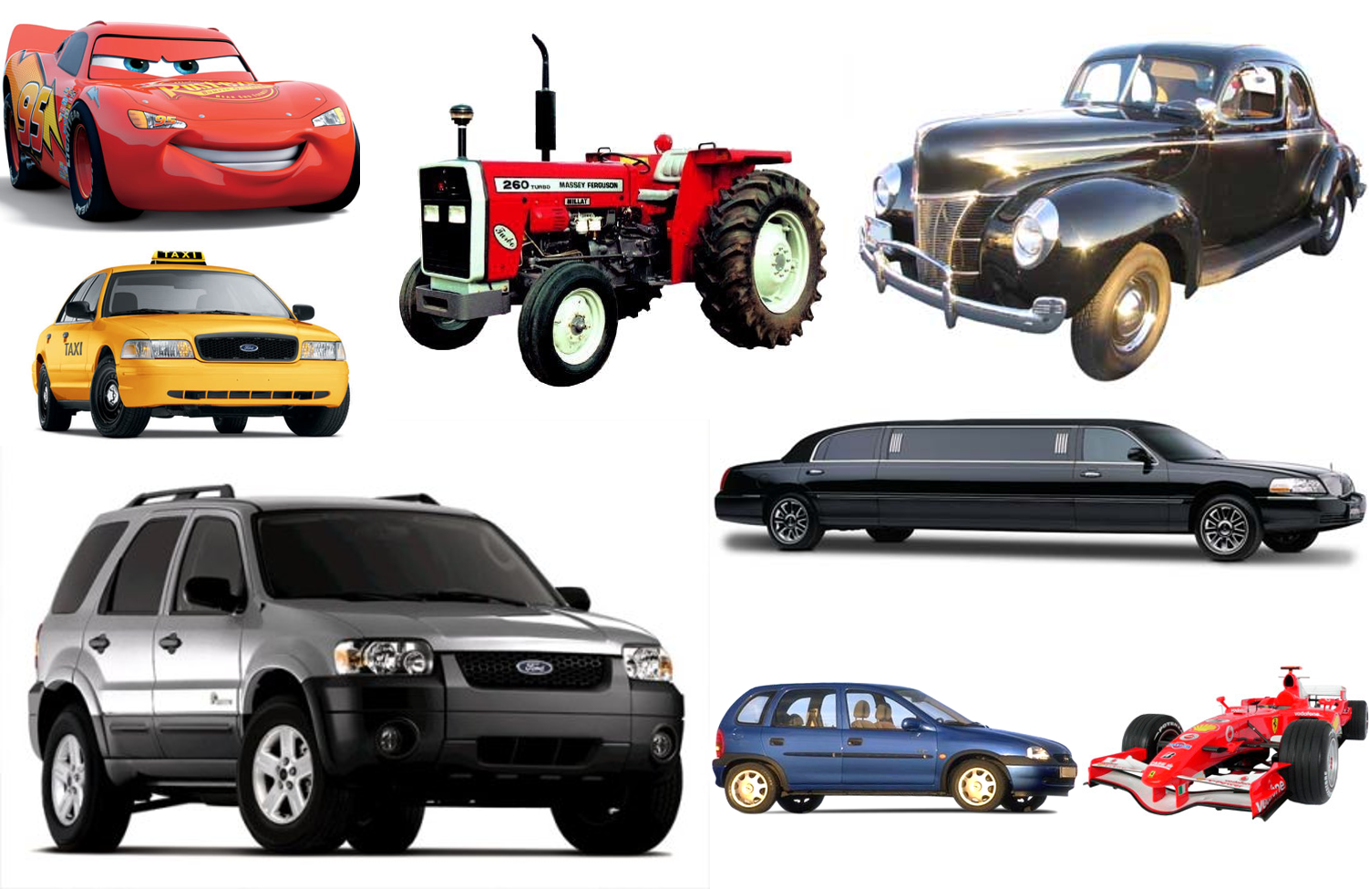
Classify Those Cars!

Slide 6
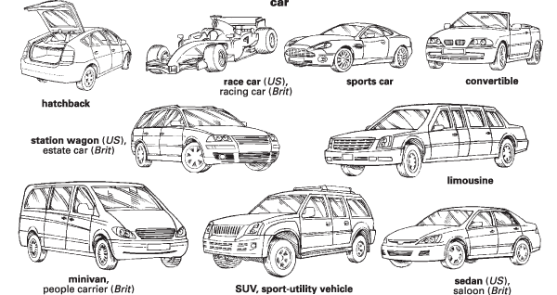
Possible Solution?

Slide 7
Possible Solution? (2)
Black
White
Red
Green
Blue
Another color
Up to 33 kW
34-80 kW
81-120 kW
Above 120 kW
Real
Imaginary

Slide 8
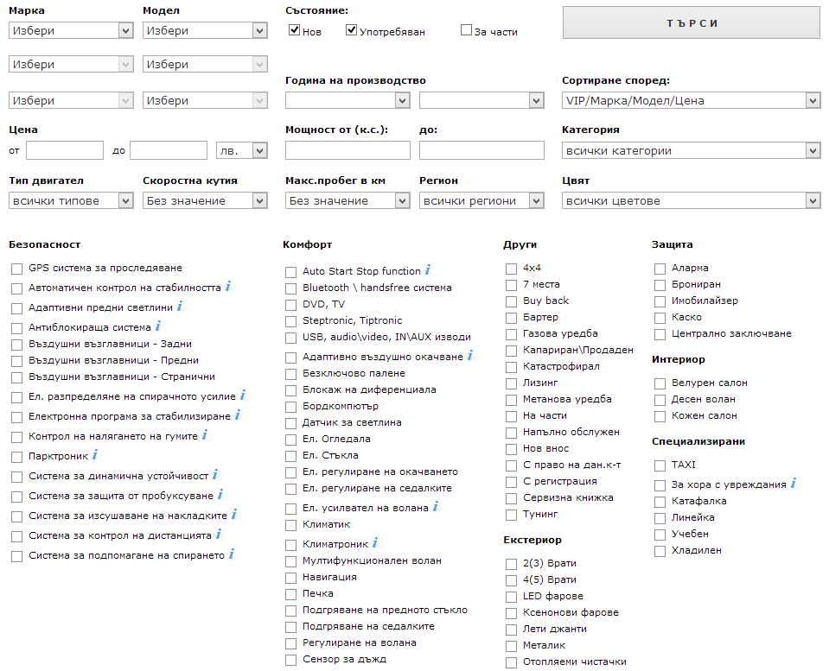
But maybe you don’t need to!

Slide 9
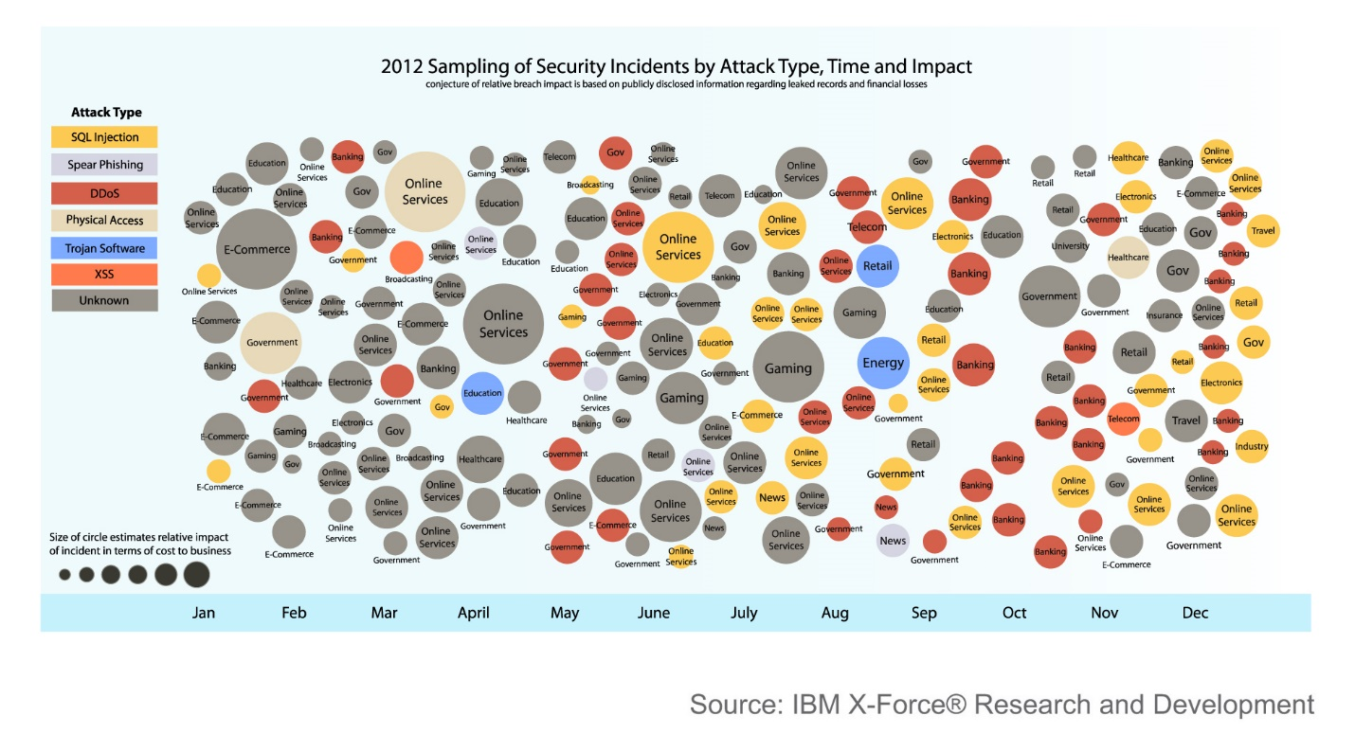
Taxonomy in Computer Science

Slide 10
Taxonomy in Software Testing
Testing
Static
Dynamic
Review
Static Analysis
Black-box
White-box
Experience-based
Defect-based
Dynamic analysis
Functional
Non-functional

Slide 11
Defect Taxonomy
Defect Taxonomy
Many different contexts
Hard to pinpoint one definition
A system of (hierarchical) categories designed to be a useful aid for reproducibly classifying defects

Slide 12
Purpose of a Defect Taxonomy
A Good Defect Taxonomy for Testing Purposes
Is expandable and ever-evolving
Has enough detail for a motivated, intelligent newcomer to be able to understand it and learn about the types of problems to be tested for
Can help someone with moderate experience in the area generate test ideas and raise issues

Slide 13
Defect-based Testing
We are doing defect-based testing anytime the type of the defect sought is the basis for the test we design
The underlying model is some list of defects seen in the past
If this list is organized as a hierarchical taxonomy, then the testing is defect-taxonomy based

Slide 14

The Defect-based Technique
The Defect-based Technique
A procedure to derive and/or select test cases targeted at one or more defect categories
Tests are being developed from what is known about the specific defect category

Slide 15
Defect Based Testing Coverage
Creating a test for every defect type is a matter of risk
Does the likelihood or impact of the defect justify the effort?
Creating tests might not be necessary at all
Sometimes several tests might be required

Slide 16

Brainstorming Test Ideas

Slide 17
What are the different ways an e-commerce shopping card can fail?
Without Taxonomy
With Taxonomy

Slide 18
Brainstorming session
Without a taxonomy
Shopping cart does not load
Unable to add/remove item
Unable to modify order
Correct item not added
Hidden functionality, not able to find checkout button
Broken URLs
Missing URLs
Able to hack the cart and change prices from client side
Customer credit card numbers compromised due to security glitch
Too generic
Database issue
Usability
Not exactly helpful
Security
And what about Performance, Accessibility, Scalability?

Slide 19
Brainstorming Test Ideas - Challenges
Lack of focus
Lack of clarity
Losing Time
Large quantity, but low quality

Slide 20
Brainstorming session (2)
With the taxonomy
The user cannot add an item directly from the search result page
Test for vulnerability to SQL query attacks
System Security
Network Failures
Poor Usability
How does the functionality fail with respect to each category?
Removing/adding an item from the cart does not update the total
Link to inventory database goes down
Timeouts of requests during peak hours
Scalability
Calculation/computation errors

Slide 21
Testing Techniques Chart
Testing
Static
Dynamic
Review
Static Analysis
Black-box
White-box
Experience-based
Defect-based
Dynamic analysis
Functional
Non-functional

Slide 22
Experience-based Techniques
Tests are based on people's skills, knowledge, intuition and experience with similar applications or technologies
Knowledge of testers, developers, users and other stakeholders
Knowledge about the software, its usage and its environment
Knowledge about likely defects and their distribution

Slide 23

Experience-based Techniques
Checklist Testing
Error Guessing
Exploratory Testing

Slide 24


Checklist Testing

Slide 25
What is Checklist Testing?
Checklist-based testing involves using checklists by testers to guide their testing
The checklist is basically a high-level list (guide or a reminder list) of
Issues to be tested
Lists of rules
Criteria to be met
Conditions to be verified

Slide 26
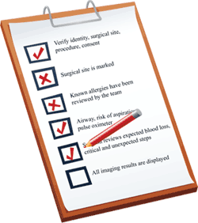
What is Checklist Testing? (2)
Checklists are usually developed and refine over time on the base of
The experience of the tester
Standards
Important functional areas
Previous trouble-areas

Slide 27
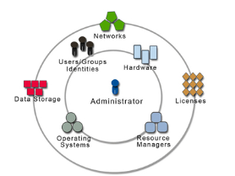
Theme Centered Organization
A checklist is usually organized around a theme
Quality characteristics
User interface standards
Key operations
Etc.

Slide 28
Exemplary Checklist
A checklist for usability of a system could be:
Accessibility
Site load-time is reasonable
Font size/spacing is easy to read
Adequate text-to-background contrast
Layout
Important content is displayed first
Related information is grouped together clearly

Slide 29

Exemplary Checklist (2)
A checklist for usability of a system could be:
Navigation
Navigation is constant on every page
Links are consistent & easy to identify
Site search is easy to access
Important links aren’t placed in moving features
Notes:
A good example for real-life checklist:
http://www.eply.com/help/eply-form-testing-checklist.pdf
Usability checklist:
http://userium.com/

Slide 30
Advantages of Checklist Testing
Checklists can be reused
Saving time and energy
Help in deciding where to concentrate efforts
Valuable in time-pressure circumstances
Prevents forgetting important issues
Offers a good structured base for testing
Helps spreading valuable ideas for testing among testers and projects

Slide 31

Error Guessing
Good Testers DO NOT Guess!

Slide 32
What is Error Guessing?
They build hypothesis where a bug might exist based on
Previous experience
Earlier testing phases or cycles
Similar or related systems
Understanding of the system under test
Design method
Implementation technology
Knowledge of typical implementation errors

Slide 33


Slide 34

Error “guessing”
Error “guessing” is not in itself a technique, but rather a skill that can and should be applied to all of the other testing techniques
WHY?
Because it can make our testing more effective
and WHY?
To produce fewer tests that could catch most of the bugs!
but WHY?
To bring more value to the project!
WHY? WHY? WHY?
Because it makes you feel smart ☺

Slide 35
Objectives of Error Guessing
Focus the testing activity on areas that have not been handled by the other more formal techniques
E.g., equivalence partitioning and boundary value analysis
Intended to compensate for the inherent incompleteness of other techniques
Complement equivalence partitioning and boundary value analysis

Slide 36
How to Improve Your Error Guessing Techniques?

Slide 37
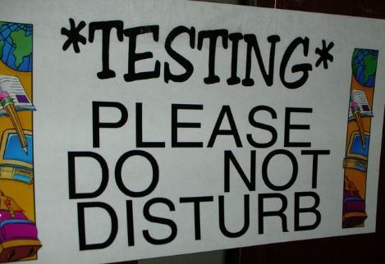
Spend more time…

Slide 38
Improve your technical understanding
Talk with Developers
Learn how things are implemented
Understand software architectures and design patterns
Dive into the code
Learn to code

Slide 39

Look for errors not only in the code
Errors also can exist in
Requirements
Design
Testing itself
Usage

Slide 40
Experience Required
Testers who are effective at error guessing use a range of experience and knowledge:
Knowledge about the tested application
E.g., used design method or implementation technology
Knowledge of the results of any earlier testing phases
Particularly important in Regression Testing

Slide 41

Experience Required (2)
Testers who are effective at error guessing use a range of experience and knowledge:
Experience of testing similar or related systems
Knowing where defects have arisen previously in those systems
Knowledge of typical implementation errors
E.g., division by zero errors
General testing rules

Slide 42

Effectiveness
Different people with different experience will show different results
Different experiences with different parts of the software will show different results
As tester advances in the project and learns more about the system, he/she may become better in Error Guessing

Slide 43
Why using it?
Advantages of Error Guessing
Highly successful testers are very effective at quickly evaluating a program and running an attack that exposes defects
Can be used to complement other testing approaches
It is more a skill then a technique that is well worth cultivating
It can make testing much more effective

Slide 44
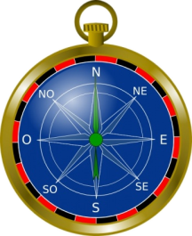
Exploratory Testing
Learn, Test and Execute Simultaneously

Slide 45



Exploratory Testing
And other…
Cem Kaner
James Bach
Michael Bolton
The term "exploratory testing" is coined by Cem Kaner in his book "Testing Computer Software"

Slide 46

What is Exploratory Testing?
What is Exploratory Testing?
Simultaneous test design, test execution, and learning.
James Bach, 1995

Slide 47
What is Exploratory Testing? (2)
The Exploratory Testing Research Summit
Simultaneous test design, test execution, and learning, with an emphasis on learning.
Cem Kaner, 2005

Slide 48
What is Exploratory Testing?(3)
What is Exploratory Testing?
A style of software testing
that emphasizes the personal freedom and responsibility of the individual tester
to continually optimize the value of his work
by treating test-related learning, test design, test execution, and test result interpretation
as mutually supportive activities
that run in parallel throughout the project
2007

Slide 49
What is Exploratory Testing?(4)
What is Exploratory Testing?
Testing is the process of evaluating a product by learning about it through exploration and experimentation, which includes: questioning, study, modeling, observation and inference, output checking, etc.
2015

Slide 50

When we are doing E.T.
We become more exploratory when we can't tell what tests should be run, in advance of the test cycle
Any testing techniques can be used in an exploratory way!
All testing is exploratory in some way…
But a skilled exploratory testing is what we aim for!

Slide 51

How we are doing it?
As long as the tester is thinking and learning while testing and the next tests are influenced by the learning
Anytime the next test we do is influenced by the result of the last test we did

Slide 52

Exploratory vs. Ad hoc Testing
Exploratory testing is to be distinguished from ad hoc testing
The term "ad hoc testing" is often associated with sloppy, careless, unfocused, random, and unskilled testing

Slide 53
Control as You Test
Design
Execute
Learn
E.T.
The tester controls the design of test cases as they are performed
Good tester doesn't just ask pass or fail… but rather “Is there a problem here”

Slide 54

It is like playing chess
The process of chess remain constant, it’s only the choices that change, and the skill of the players who choose the next move

Slide 55

Testing is all about exploration, discovery, investigation, and learning
It is a conscious process
Testing can be assisted by machines, but can’t be done by machines alone

Slide 56

Exploratory Testing Styles
Learning dominant
Intuitive
Systematic
Regression

Slide 57

Intuitive Styles
The most common style
Testers without much Exploratory Testing experience do this naturally
Their testing is based on their intuition – synthesized from experience and knowledge
Difficult to explain to others because of the internalized nature of its basis. The “magic” just happens

Slide 58

Learning Dominant Styles
Try out the software guided by:
User stories
Models and maps
Touring heuristics
Find all the features, try every function, traverse the system based on different personas

Slide 59
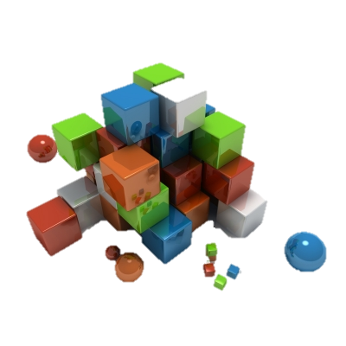
Systematic Styles
More advanced exploratory testing
Involves using a particular system, model, or strategy to guide your testing
This is done to be more:
thorough in looking at and testing the system
consistent in our exploratory testing work
Notes:
http://www.qualityperspectives.ca/resources_mnemonics.html

Slide 60

Regression Styles
There is no escaping death, taxes, and regression testing
In Exploratory Testing, the guidance is lightweight and concise
Checklists
Coverage diagrams
Coverage maps
Application maps

Slide 61

Scripted vs. Exploratory Testing

Slide 62
Scripted Testing
A Script (low level test case) specifies
the test operations
the expected results
the comparisons the human or machine should make
These comparison points are useful in general, but many times fallible and incomplete, criteria for deciding whether the program behaves properly
Scripts require a big investment
to create
even more to maintain and keep them up to date

Slide 63
Benefits of Scripting Testing
Careful thinking about the design of each test, optimizing it for its most important attributes
Review by other stakeholders
Reusability
Can be helpful for building regression automation suite from another person
Known comprehensiveness of the set of tests
If we consider the set sufficiently comprehensive, we can calculate as a metric the percentage completed of these tests

Slide 64
Drawbacks of Scripting Testing
Time sequence in scripted testing
Design the test early
Execute it many times later
Look for the same things each time
The high-cognitive work in this sequence is done during test design, not during test execution

Slide 65

Drawbacks of Scripting Testing (2)
We pay attention to some things and therefore we do not pay attention to others
Even events that “should be” obvious will be missed of we are attending to other things

Slide 66
Exploratory Testing
Time sequence in exploration
Execute the test at time of design
Design the test as needed
Vary the test as appropriate
Unscripted doesn’t mean unprepared. It’s about enabling choice not constraining it

Slide 67
Exploratory Testing (2)
The exploratory tester is always responsible for managing the value of her own time
At any point in time, this might include
Reusing old tests
Creating and running new tests
Creating test-support artifacts, such as failure mode lists
The explorer can do any combination of learning,
designing executing and interpreting at any time

Slide 68
Scripted vs. Exploratory Testing
Scripted Testing | Exploratory Testing
Directed from elsewhere | Directed from within
Determined in advance | Determined in the moment
Is about confirmation | Is about investigation
Is about controlling tests | Is about improving test design
Emphasizes predictability | Emphasizes adaptability
Emphasizes decidability | Emphasizes learning
Like making a speech | Like having a conversation
Like playing from a score | Like playing in a jam session

Slide 69
Concerns with Exploratory Testing
Limited test reusability
Limited reproducibility of failures
Cannot be managed
Low Accountability – no metrics, no reports, no proof
Most of them are myths!

Slide 70
Session-Based Test Management
Software test method that aims to combine accountability and exploratory testing to provide rapid defect discovery, creative on-the-fly test design, management control and metrics reporting
Jonathan Bach, 2000

Slide 71
Session-Based Test Management
Elements:
Charter – includes a clear mission statement and areas to be tested
Time-Box – an uninterrupted period of time spent testing
Reviewable result – session sheet test report
Debrief
Understand the session report
Learning and coaching
Notes:
http://www.satisfice.com/sbtm/sample_session.htm

Slide 72
Session-Based Test Management Example
CHARTER
Analyze View menu functionality and report on areas of potential risk
AREAS
OS | Windows 10 Menu | View Strategy | Function
START: 08.01.2016 10:00 AM
END: 08.01.2016 11:00 AM
TESTER:

Slide 73
Session-Based Test Management Example
TEST NOTES
I touched each of the menu items, below, but focused mostly on zooming behavior with various combinations of map elements displayed.
View: Welcome Screen, Navigator, Locator Map, Legend, Map Elements Highway Levels, Zoom
Levels Risks:- Incorrect display of a map element.- Incorrect display due to interrupted
BUGS
#BUG 1321 Zooming in makes you put in the CD 2 when you get to acerta in level of granularity (the street names level) --even if CD 2 is already in the drive.
ISSUES
How do I know what details should show up at what zoom levels?

Slide 74

Exploratory Testing Mind Maps

Slide 75
Balancing Scripted Testing and Exploratory Testing
Testing usually falls in between the both sides:
Depends on the context of the project
Roles
Vague scripts
Fragment test cases (scenarios)
Pure scripted
Charters
Freestyle

Slide 76
Defect-based and Experience-based Techniques
?
?
?
?
?
Questions?
?
?
?
?
?
?

Slide 77
References
Testing Computer Software, 2nd Edition
Lessons Learned in Software Testing: A Context-Driven Approach
A Practitioner's Guide to Software Test Design
http://www.satisfice.com/articles.shtml
http://kaner.com
http://searchsoftwarequality.techtarget.com/tip/Finding-software-flaws-with-error-guessing-tours

Slide 78




Free Trainings @ Telerik Academy
C# Programming @ Telerik Academy
csharpfundamentals.telerik.com
Telerik Software Academy
academy.telerik.com
Telerik Academy @ Facebook
facebook.com/TelerikAcademy
Telerik Software Academy Forums
forums.academy.telerik.com

